Slide 1
SME Credit Scorecard Development
SR&T Senior Consultant, Regulatory & Financial Risk: Risk Modelling
Le Thi Kim Ngan | Candidate Presentation
March 2026

Slide 2
Background & Data Overview
SME portfolio scorecard — expert-weighted system under review
Context
Feature Summary
Dataset
557 SME borrowers, 8 features, 9.0% default rate
Code
Feature
Type
IV
Expert Wt
Target
Default Flag (1 = default, 0 = non default)
C1
Debt Restructuring History
Cat
1.17
12.5%
Scorecard
Expert-weighted, C + F components, score per bin
C2
Debt Rescheduling History
Cat
0.57
12.5%
C Component
50% weight
C3
Worst CB Delinquency 2yr
Cat
5.43
25.0%
F Component
50% weight: F1–F5 financial ratios equally at 10% each
F1
Net Fixed Asset
Num
2.60
10.0%
Missing Data
C2: 282 NaN (51%), Net Fixed Asset: 26 (5%)
F2
Net Profit Margin (%)
Num
1.28
10.0%
F3
Sale Growth (%)
Num
0.04
10.0%
Sentinels
99999998/99999999
F4
Debt-to-Equity Ratio
Num
1.46
10.0%
Objective
Assess expert weights using quantitative analysis ; develop LR-based PD model
F5
Debt Service Coverage Ratio
Num
1.58
10.0%

Slide 3
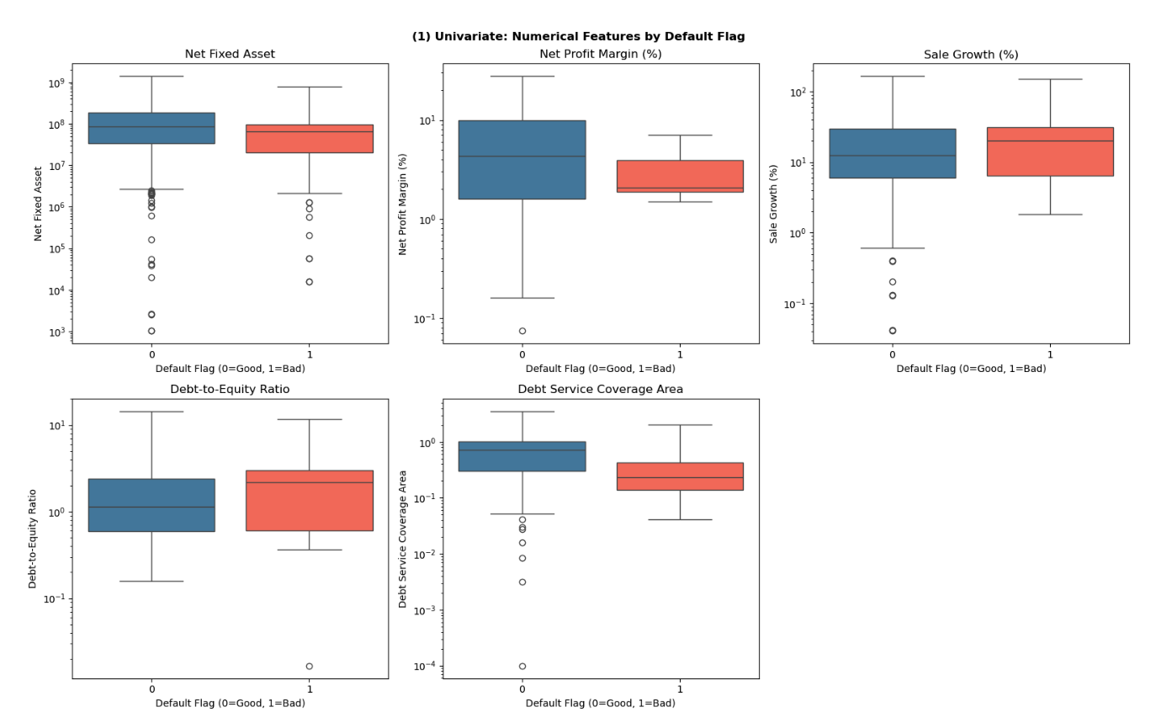
EDA: Univariate Analysis
Distribution and default rates across categorical and numerical features
Key Observations
▸ F1 - Net Fix Asset
Data have high variance and outliers. Fix asset of firms that not defaults have higher mean
▸ F4 - DSCR
Defaulters concentrated at lower DSCR; non-defaulters spread across positive values
▸ F2 - Net Profit Margin
Heavy left-skew, median near -8%; most SMEs unprofitable
▸ F3 - Sale Growth
Quantile 1 and 3 of defaulter and non defaulter are approximately the same, many zero-growth observations

Slide 4
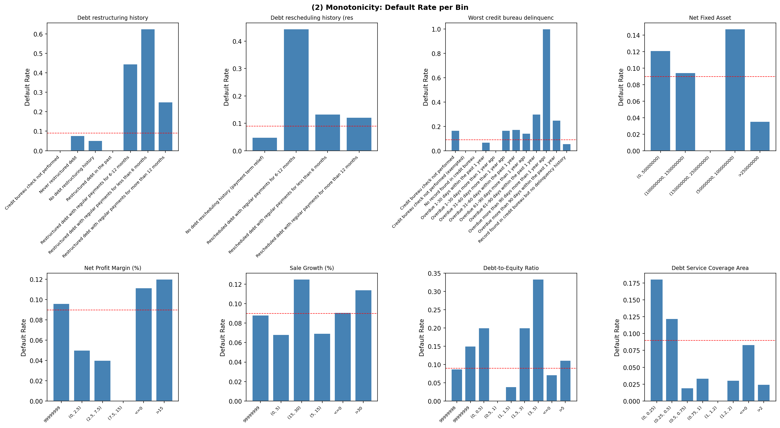
EDA: Monotonicity Analysis
Monotonicity Findings:
▸ C1 Restructuring:
▸ C3 CB Delinquency:
▸ F4 D/E Ratio:
Non-monotone: "Never restructured" has lower WoE than "No history" - bins should be merged
Broadly monotone: longer overdue → higher WoE
Partially monotone; (0.5,1) bin has zero defaults

Slide 5
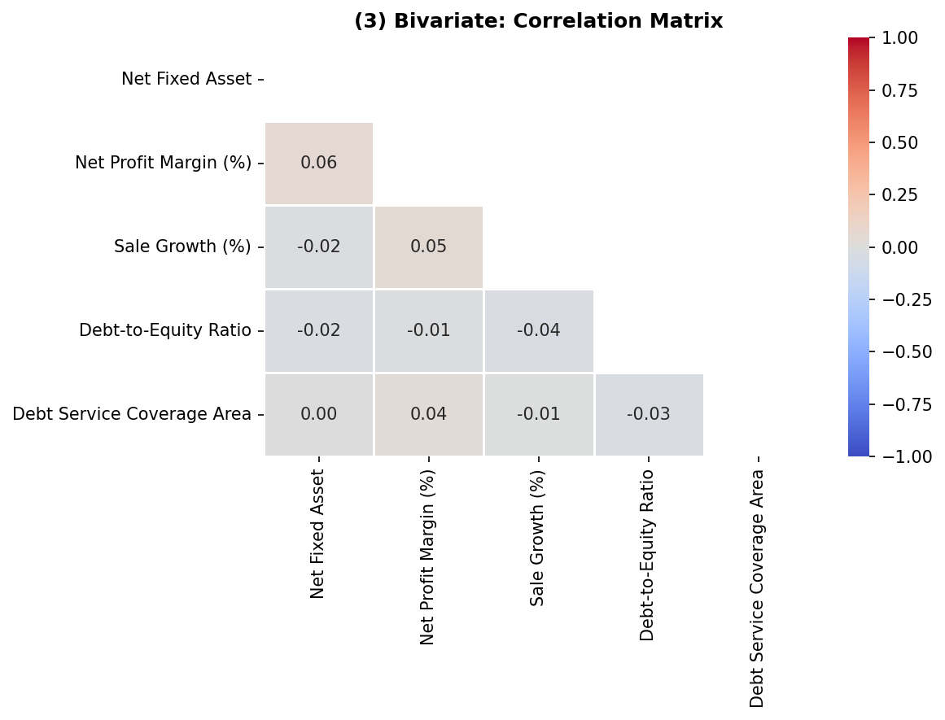
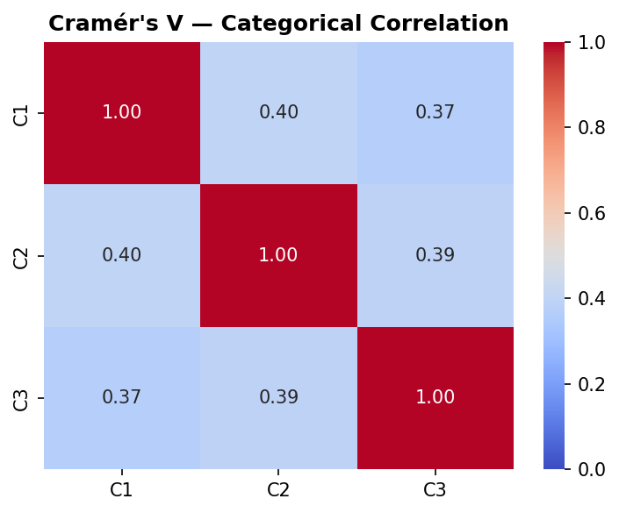
EDA: Correlation & Multicollinearity
Pearson correlation for numerical features; Cramér's V for categorical pairs
Multicollinearity Findings
• Cramér's V: moderate correlation among credit history features
• Net Profit Margin and Net FIx Asset show weak correlation
• No severe multicollinearity

Slide 6
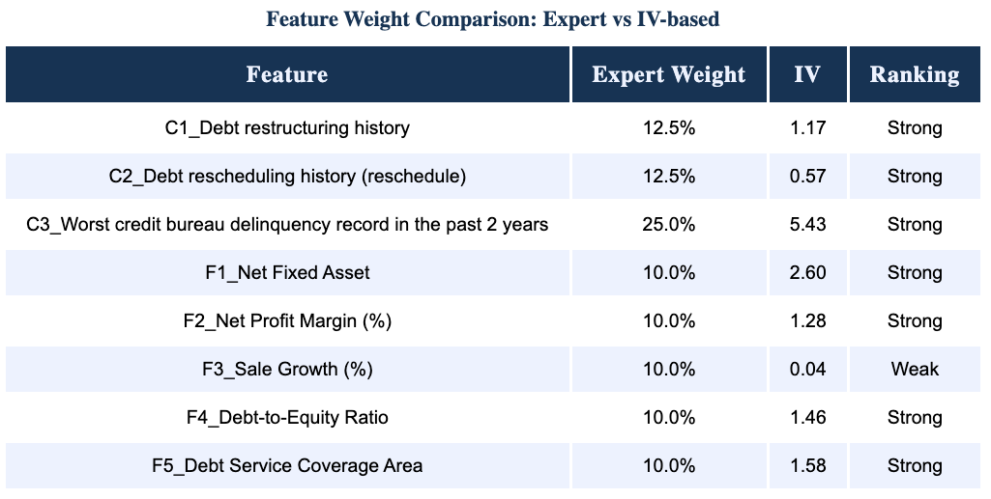
Q1: Feature Weight Assessment
Apprach 1: Information Value (IV) as objective measure vs expert-assigned weights
(*) IV calculation and ranking from book Intelligent credit scoring - Naeem Siddiqi
Recommendation: Proposed Weight Rebalancing
Using IV to assess predictive power:
- Sale Growth (IV=0.04) shows negligible signal and should be removed.
- F1_Net Fixed Asset outperform F2_Net Profit Margin and F4_Dept-to-Equity Ratio
- C1_Dept restructuring history have more predictive power than C2_Dept rescheduling history (reschedule)

Slide 7
√
Q1: Feature Weight Assessment
Approach 2: Calculating weights using linear regression model
LR Coefficients & Normalised Importance
Feature
Coef
LR Wt%
Expert
C3 Worst CB Delinquency
0.897
26.60%
25%
F4 Debt-to-Equity Ratio
0.745
22.17%
10%
F5 DSCR
0.545
16.22%
10%
C2 Debt Rescheduling
0.469
13.96%
12.5%
F1 Net Fixed Asset
0.282
8.43%
10%
C1 Debt Restructuring
0.238
7.09%
12.5%
F2 Net Profit Margin
0.182
5.52%
10%
Recommendation: Proposed Weight Rebalancing
Increase weights on highest-impact leverage
(1) Debt-to-Equity Ratio - second strongest predictive feature (currently underweighted by ~12 %)
(2) Debt Service Coverage Ratio (DSCR) - underweighted by ~ 6%
Decrease weights on features
(1) Debt Restructuring History
(2) Net Profit Margin

Slide 8
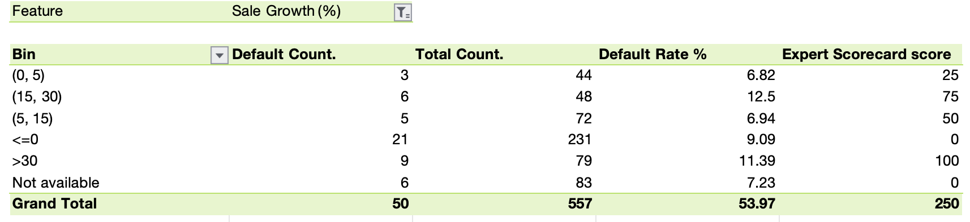
√
Q2: Scorecard Enhancement Suggestions
Approach : Validate monotonicity - default rate must strictly increase band-by-band
Recommendation: F3 Sale Growths - cap binning the score
Current scorecard score contradict default rate trend
Higher sales growth is associated with greater default risk
> Suggesting that aggressive growth may signal financial distress rather than stability.

Slide 9
Q3: EDA Methodology for Credit Risk Datasets
Structured five-step framework for borrower, financial and macroeconomic data
Step 1 Data Quality
Step 2 Univariate
Step 3 Bivariate
Step 4 IV/WoE
Step 5 Macroeconomic
• Missing value audit & sentinel detection
• Categorical: frequency, default rate per bin, concentration check
• Numerical vs Target: KS test, Pearson correlation
• Quantify predictive power per bin
• Usually affect the whole portforlio or segment
• Skewness check, IQR-based outlier treatment
• Numerical: histogram, boxplot, describe()
• Categorical vs Target: Chi-square, Cramér's V
• Shoud be consider as a adverse or favorable variable
• Duplicate and data type validation
• Flag features with >50% single-bin concentration
• Should be monitor in at least 1 business cycle
• Two-stage model: micro scorecard + macro adjustment

Slide 10


Q4: PD Model Development — Logistic Regression
Theory, assumptions and implementation steps
Model Theory
Implementation Steps
▸ General formulation
1
1. Data Preparation
WoE encoding linearises the log-odds relationship
$$f(x) =θ(w^{T}x)$$
▸ MLE estimation
2
2. WoE Encoding
Parameters estimated by minimizing negative log-likelihood function
Compute WoE per bin
$$J(w) = −\sum_{i=1}^{N}{(yᵢ logzᵢ +(1−yᵢ )log(1−zᵢ)}$$
3
3. Train/Test Split
▸ Have no close form soluion
Approximate close solution by iterating
80/20 stratified split; EPV check (need ≥10 defaults per feature)
w=w+η(yi​−zi​)xi​
4
4. Model Training
Assumption
Set stopping condition when loss funcion small enough or by iteration
▸ Binary or Ordinal Dependent Variable
5
5. Validation
▸ Independence of Observations
6
5. Score Mapping
▸ Absence of Multicollinearity
Score_i = Offset + Factor×β₀ + Σ[−Factor×βᵢ×WoEᵢ]
▸ Linearity of Independent Variables with the Log-Odds
7
6. PDO Calibration
▸ No extreme outliers
Allocating rating classes to entities to ensure the calibration power of the division created is as high as possible

Slide 11
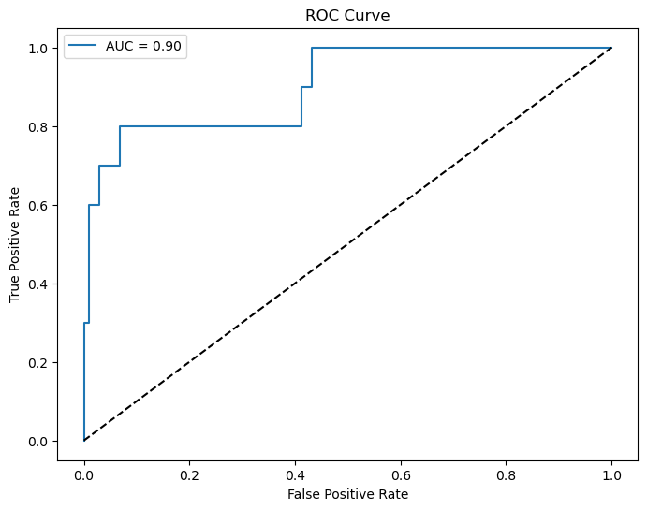
Q5: Model Evaluation Framework
Three pillars: goodness-of-fit, discriminatory power, accuracy
Pillar 1 Goodness-of-Fit
Pillar 2 Discriminatory Power
Pillar 3 Forecasting Accuracy
Hosmer-Lemeshow Test
AUC-ROC = 0.90
PSI — Population Stability
Groups: 10
Hosmer-Lemeshow Statistic: 4.8454
Degrees of Freedom: 8
P-value: 0.7740
Good fit — fail to reject H0
Model ranks 90% of default/non-default pairs correctly Excellent - robust even with extreme WoE values Gini Coefficient = 2×AUC−1 = 0.80
precision recall f1-score support
0 0.96 0.99 0.98 102
1 0.86 0.60 0.71 10
accuracy 0.96 112
macro avg 0.91 0.80 0.84 112
weighted avg 0.95 0.96 0.95 112
Binomial Test
Observed Defaults: 10
Total Borrowers: 112
Expected PD (avg): 0.116
Expected Defaults: 12
p-value: 0.46
Fail to reject H0 — predicted default rate matches observed

Slide 12
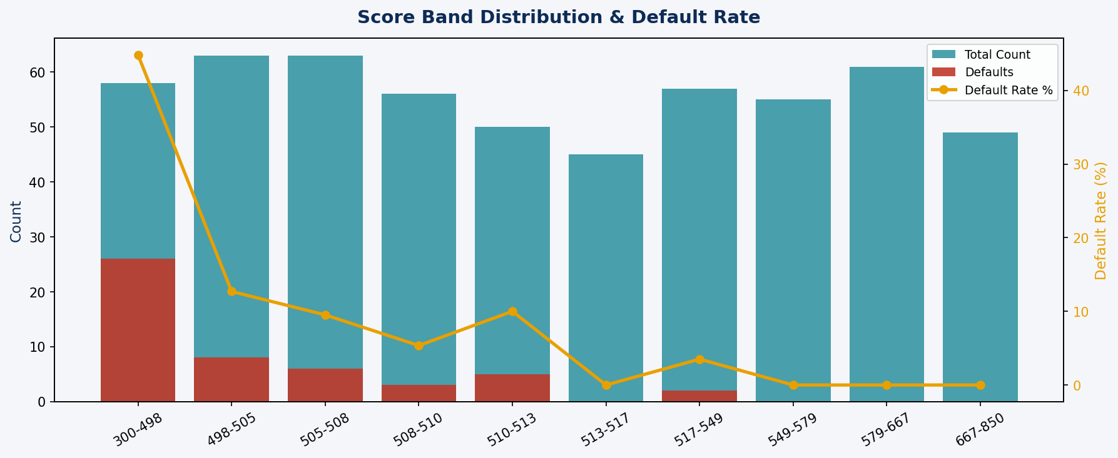
Score Distribution Analysis
PDO-calibrated scores mapped to 300–850 range with band-level default rates
PDO Calibration
PDO
20 (score doubles odds per 20 pts)
Base Score
600 at odds 50:1
Factor
PDO/ln(2) = 28.85
Offset
Base − Factor×ln(Base_Odds) = 487.1
Intercept
Factor × β₀ = 10.55
Score Range
300–850 (min-max scaled)
Score Band Findings
• 300–498: 44.8% default rate → High Risk
• 498–513: 5–13% default rate → Medium Risk
• 513+: 0–3.5% default rate → Low Risk
• Clear separation validates model discrimination
• Bands 513–850: 0 defaults in top 5 bands

Slide 13
Conclusion
Based on quantitative analysis, three actions are recommended to strengthen the scorecard:
01
Reassess the Weights of Risk Components
02
Adjust Bins and the Formulated Scorecard
03
Combine Quantitative Model with Expert Model
• C3 (Worst CB Delinquency) is the strongest predictor with IV = 5.43 — its 25% weight is justified and may warrant an increase to 30%
• Merge non-monotone bins where WoE direction breaks the expected risk ordering (e.g. C1 Restructuring)
• Use LR-implied coefficients to cross-validate expert weights — flag features where the gap exceeds 5 percentage points
• F3 Sale Growth has IV = 0.04, below the acceptable threshold — it should be removed or replaced with a more predictive variable
• Cap extreme values at 5th–95th percentile before binning to reduce sensitivity to outliers in skewed features
• Adopt a hybrid approach: data-driven weights as the baseline, with expert overlay for features with limited historical data
• D/E Ratio and DSCR are underweighted relative to their data-implied importance — consider increasing both to 15%
• Validate monotonicity after each bin adjustment — default rate must strictly increase from best to worst bin
• Incorporate macroeconomic variables (GDP growth, interest rates) in a two-stage model: micro scorecard × macro scalar
• Use IV as the primary basis for weight assignment rather than expert judgement alone

